Slide 1
TRANSFORM
Strategies to Advance Women in Higher Education
Melanie Hatch, Ph.D.
Virginia Arp, Elisa Konieczko, Sreela Sasi, Weslene Tallmadge, Karinna Vernaza, Theresa Vitolo

Slide 2
Outline
Introduction
TRANSFORM Goals and Objectives
Strategies
Dual Career Services
Research Initiation Award for Early-Career Faculty or for Mid-Career Faculty
Leadership Development

Slide 3
Leadership and Gender
Does it really matter?
Caliper Group (2005)
Women are more persuasive and inclusive
Women take more risks
C. Brush (2006)
Women see interconnected relationships
Encouragement and motivation
Need female perspective!

Slide 4
Women in STEM*
Hold ½ of all jobs but fewer than 25% in STEM disciplines
Women in STEM-related jobs earn 33% more than in non-STEM jobs
Only 25% or women with STEM-related degrees work in STEM-related jobs
Majority of female STEM majors choose physical or life sciences (men choose engineering)
*www.esa.doc.gov

Slide 5
Women in STEM at GU
We have approximately 200 total faculty
48% are women and 28% of STEM faculty are women
Women faculty by rank*
Assistant Professors – 33%
Associate Professors – 33%
No women full professors
Limited opportunities for employment of spouses
*At the time of grant application

Slide 6
Women in Leadership Positions
Vice President Level*
Four male and one female
Dean Level
One male and two female
Department Chair (STEM)
Six male and two female
*At time of grant application

Slide 7
Why So Few? presents evidence that social and environmental
factors contribute to the underrepresentation of
women and girls in STEM
Eight research findings in three areas:
How social and environmental factors
shape girls’ achievements and interests
in math and science
The climate of college and university
science and engineering departments
Continuing influence of bias
Source: American Association of University Women, Why So Few? Women in Science, Technology, Engineering, and Mathematics, 2009.
Notes:
The project brings together current research findings the potential to influence public understanding on gender issues in science, technology, engineering and mathematics. In particular, we sought research that could counter cultural beliefs about women’s capacity in mathematics and science, their interest in STEM and their ability to withstand the rigors of a careers in STEM fields.
AAUW drew on the large body of academic research on gender and science, and conducted interviews with top researchers and identified eight research findings that help to explain the underrepresentation of women and girls in STEM. Using multiple databases, including the web of science, ProQuest, Social Science citation index and J-Stor, AAUW staff identified and reviewed hundreds of articles from fields such as psychology, sociology, education and cognitive science and identified eight research projects. These projects have findings that are well respected in the research community, as measured by publication in peer-reviewed journals, the number of citations, and other forms of public recognition.
These eight research findings fall on the nurture side of the nature-nurture debate, and each supports that social and environmental factors clearly contribute to the underrepresentation of women in science and engineering.
The research findings are organized into three areas:
How social and environmental factors shape girls’ achievements and interests in math and science;
How the climate of university science and engineering departments affects women’s—both students and faculty—experience in STEM fields; and
The continuing role of bias in limiting women’s success in STEM in education and the workplace.

Slide 8
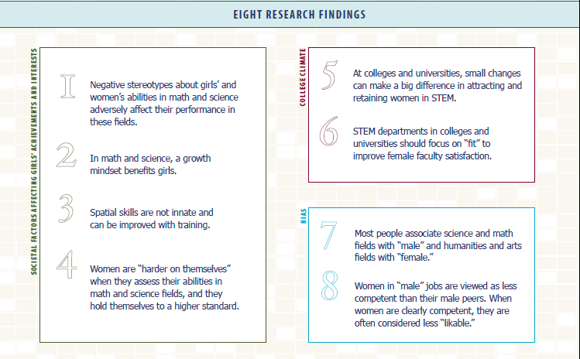
Notes:
Here are the 8 research findings

Slide 9
Background
National Science Foundations, Division of Human Resource Development
Partnerships for Adaptation, Implement and Dissemination (ADVANCE-PAID)
TRANSFORM, Teaching Research Advancement Network to Secure Female Faculty For Organizational Retention and Management
Applied in November 2010
Grant of $385,919 awarded in September 2011

Slide 10
TRANSFORM
Goal
To increase the recruitment, retention, advancement, and leadership development of STEM female faculty at Gannon.
Vision
To have Gannon University be regionally recognized as an institution supporting and developing female faculty throughout their careers.

Slide 11
Four Objectives
#1
Recruit female faculty in STEM disciplines
#2
Retain and Advance female faculty through the rank and tenure process
#3
Prepare female faculty to hold leadership positions
#4
Educate deans, department chairs, and faculty leaders about issues affecting female faculty
``

Slide 12
Strategy 1
Dual Career Services

Slide 13
Strategy 1: Dual Career Services
Objective 1: Recruitment of STEM female faculty members
Activity 1:
Create Dual Career Services Office
Initial site, Gannon, HR
Activity 2:
Create and manage DCCNP website
Contracted, external development
Available to registered employees affiliated with consortium
Activity 3:
Implement Dual Career Program
Institutionalization of shared policies and expectations
Oversees usage and value of website
Institutes Dual Career Consortium of Northwestern Pennsylvania (DCCNP)
Consortium builds alliances with regional employers
Requires support of part-time employee

Slide 14
Progress to Date Strategy 1: Dual Career Services
Recruited all local universities
Indentified set of local businesses
Hired HR firm
Advertised for programmer/database administrator

Slide 15
Strategy 2
Research Initiation Award for Early-Career Faculty or for Mid-Career Faculty

Slide 16
Strategy 2: Research Initiation Award
Objective 2: To increase the number of Gannon female faculty achieving advancement in rank
Activity 1:
Implement Research Initiation Award
Inform the STEM Department Chairs about the new “Research Initiation Award”
Solicit proposals from the qualified candidates
Review proposals and announce the awardees
Review interim progress report and final report

Slide 17
Progress to Date Strategy 2: Research Initiative Award
Research proposals solicited from female, Assistant and Associate Professors of STEM disciplines
Six proposals received from 12 potential candidates
Review of proposals in progress
Awardee receives
3 credits release time per semester/2 years
$7500 as grant funds

Slide 18
Strategy 3
Leadership Development

Slide 19
Strategy 3: Leadership Development
Objective 3: Prepare female faculty to hold leadership positions
Objective 4: Educate deans, department chairs, and faculty leaders about issues affecting female faculty

Slide 20
Strategy 3: Activity 1
Activity 1:
Leadership Development Training
Develop a curriculum to prepare all faculty for leadership positions
Organize topics into three main categories:
Interpersonal Relationships and Communications
Task
Leadership and Vision
Offer each academic year, six one-hour events through different formats (webinars, invited speakers, panels)

Slide 21
Strategy 3: Activity 1 Proposed Curriculum for Year 1 and 2
 | Leadership and Vision | Task Topics | Interpersonal
Spring 2012
January | Leadership Self Assessment
February |  | Goal Setting
April |  |  | Conflict Management
Fall 2012
September | Contemporary Approach to Leadership Development
October |  | Time Management
November |  |  | Mentoring
Spring 2013
January | Values and Vision
February |  | Decision Making
April |  |  | Motivation

Slide 22
Progress to Date Strategy 3: Leadership Development
Activity 1: Leadership Development Training
Two workshops conducted to date; two hours long
Survey Results
Leadership Series # 1: 73% strongly agreed and 27% tend to agree that the content was beneficial and that they will be able to apply the ideas to their job.
Leadership Series # 2: 59% strongly agreed and 35% tend to agree that their was a good balance between presentation and group involvement.
 | Date | Topic | Participants
Leadership Series # 1 | January 27, 2012 | Self- Assessment using DISC Behavioral Analysis | 17
Leadership Series # 2 | February 17, 2012 | Situational Leadership | 17

Slide 23
Survey Results: Leadership Series # 1
 | Strongly Agree | Tend to Agree | Neither Agree or Disagree | Tend to Disagree | Strongly Disagree | Undecided | Not Applicable | Totals
1. I am pleased with the overall quality of this workshop. | 10 | 5
2. I will be able to apply one or more ideas to my course or to my job. | 11 | 4
3. Overall, the presenter/instructor was effective in presenting the information. | 12 | 3
4. There was a good balance between presentation and group involvement. | 9 | 5 |  |  | 1
5. The timing and pace of the event was adequate. | 6 | 7 |  | 2
6. The content of this workshop/seminar/webinar was beneficial. | 11 | 4

Slide 24
Survey Results: Leadership Series # 2
 | Strongly Agree | Tend to Agree | Neither Agree or Disagree | Tend to Disagree | Strongly Disagree | Undecided | Not Applicable | Totals
1. I am pleased with the overall quality of this workshop. | 7 | 9 | 1
2. I will be able to apply one or more ideas to my course or to my job. | 9 | 7 |  |  |  |  | 1
3. Overall, the presenter/instructor was effective in presenting the information. | 9 | 8
4. There was a good balance between presentation and group involvement. | 10 | 6 | 1
5. The timing and pace of the event was adequate. | 8 | 6 | 3
6. The content of this workshop/seminar/webinar was beneficial. | 8 | 7 | 2

Slide 25
Strategy 3: Activity 2
Activity 2:
Leaders Forum for Climate Change
Develop a curriculum addressing female faculty barriers
Audience: department chairs, program directors, deans, provost, associate provost, administrators
Establish three, half-day leadership workshops
Goal: Climate change
First implementation March30, 2012
Topic: Fair Faculty Evaluations

Slide 26
Strategy 3: Activity 3
Activity 3:
Regional Leadership Symposium
Focus: Issues facing leaders in higher education
Follow the model set by GU Regional Symposium on Teaching and Learning
Appropriate Keynote Speaker to be selected
First implementation Summer of 2014

Slide 27
Budget Five Year Allocation
Budget Categories | Total Direct and Indirect Costs ($)
Strategy 1: Dual Career Services | 67,586
Strategy 2: Research Initiation Award | 187,375
Strategy 3: Leadership Developments | 29,975
Personnel | 64,983
Travel to NSF PI Conference | 18,000
External Evaluator | 18,000
TOTAL FEDERAL AWARD | 385,919

Slide 28
Acknolwedgement
This work is supported by the National Science Foundation Award HRD-1107015.
Questions

