Slide 1
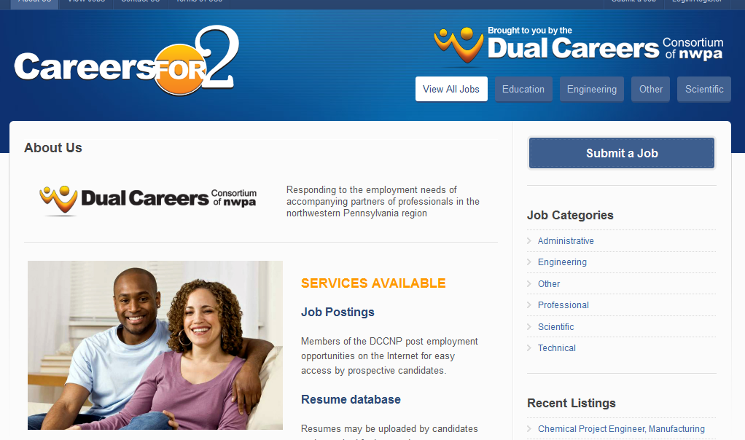
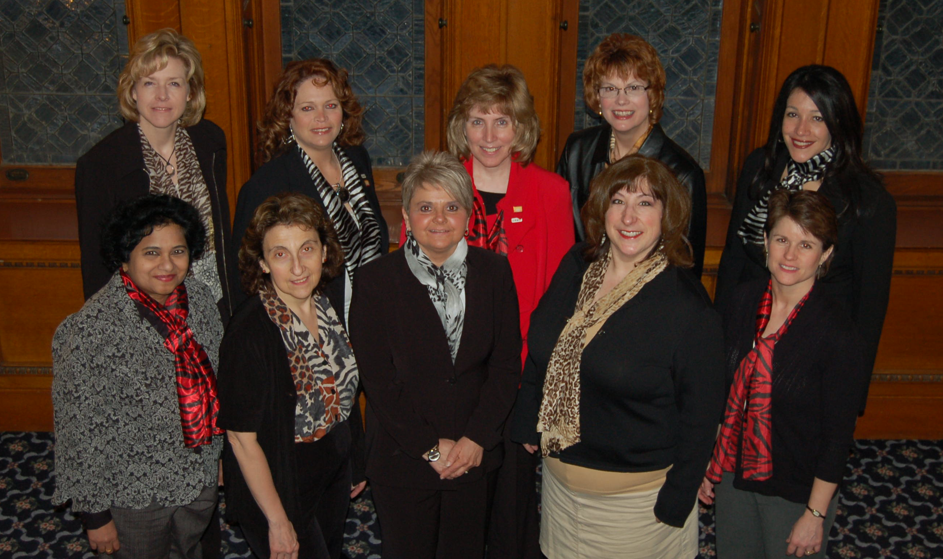
Securing Female Faculty for Organizational Retention and Management: Progress and Challenges of the First Year (2012)
W. T. Tallmadge, Ph.D., T. M. Vitolo, Ph.D., K. M. Vernaza, Ph.D., E. M. Konieczko, Ph.D., V. P. Arp, M.Ed., S. Sasi, Ph.D., M. Hatch, Ph.D.
Gannon University, Erie, PA
Abstract
Changes: Female Faculty in STEM at Gannon University
www.careersfor2.com
Strategy Three: Leadership Developments
Internal Evaluator Report
The PAID grant TRANSFORM --- Teaching-Research-Advancement Network to Secure Female Faculty for Organizational Retention and Management -- deploys three strategies to help Gannon University more effectively recruit, retain, and advance women faculty in the STEM disciplines. Strategy-1 establishes the Dual Career Consortium of Northwestern Pennsylvania (DCCNP) to offer career networking opportunities for partners of hired faculty. Alliances among regional employers and a career website are made available to registered users. As an initiative encompassing units beyond the university’s boundaries, the challenges are coordination and management of the diverse elements. Strategy-2 seeks to increase the number of female STEM faculty achieving advancement in rank through the Research Initiation Award. The first-year awardee made significant progress in her research having received the benefit of the funded release time and money. The challenge, here, centers on the discernment required to choose amongst all qualified proposals. Finally, Strategy-3 provides leadership development for faculty and educates administrators regarding issues affecting female faculty. The third strategy addresses the changing needs for those current and aspiring leaders within the institution. Through these three strategies, the grant impacts the changing culture at the university.
First, female faculty constitute a low percentage of the STEM faculty.
Second, female faculty do not have a strong presence at higher ranks.
Objective: The activities of the third strategy help to realize the third and fourth objectives of the TRANSFORM grant. The strategy increases the number of continuing education opportunities for female faculty in the areas of leadership and educates administrators on the issues affecting success of STEM female faculty. These objectives are accomplished through the establishment of Leadership Trainings, a Leadership Forum, and a Regional Leadership Symposium.
Progress: During Year One, three leadership trainings (2.5 hours each) and one leadership forum for chairs (2.5 hours each have been offered per semester. The first Regional Leadership Symposium will take place on May 2014.
Challenges:
Provide opportunities and experiences for those interested in developing their leadership capabilities.
Initial budget allocation is not sufficient to bring many external speakers during the semester.
Formative evaluation was conducted by Dr. Constantine Kliorys, Senior Fulbright Scholar in Mathematics and Professor in the Dahlkemper School of Business with background on algebraic number theory. He evaluated the four main objectives between 9/1/2011-8/31/2012 :
Objective 1: “Good progress has been made in this area.”
Objective 2: “This objective is in its early stages... the expected efforts for Year 1 have occurred.”
Objective 3: “Substantial results were obtained for this objective. The seminars were well organized, enthusiastically attended, and resulted in positive feedback as to their efficacy.”
Objective 4: “The annual regional symposium has not been held yet. It is planned for May 2014. Seminars held at Gannon University should provide a solid base for the planned annual Regional Leadership Symposia.”
Year | Total | Women | % of Women
2009-2010 | 64 | 18 | 28.13
2010-2011 | 66 | 22 | 33.33
2011-2012 | 65 | 21 | 32.31
Rank | 2009-2010 | 2010-2011 | 2011-2012
Professor – M | 11.0% | 11.2% | 13.7%
Professor – F | 2.0% | 2.0% | 3.6%
Associate – M | 13.5% | 14.3% | 13.2%
Associate - F | 10.5% | 12.8% | 12.2%
Assistant – M | 23.5% | 20.4% | 19.8%
Assistant - F | 23.5% | 22.4% | 21.3%
Strategy Two: Research Initiation Grant
SPRING 2012 Series
Date | Topic | Attendance | Delivery Method
27 Jan | Leadership and Self Knowledge (DISC) | 17 | Tom Benson, Vice President, J.L. Nick Associates, Inc.
17 Feb | Team Building | 17 | Thomas Comstock, Adjunct Faculty Member, MBA Program
30 Mar | Department Chairs Session on Academia Gender Equality | 8 | Videos; Karinna Vernaza and Virginia Arp
20 April | Least Preferred Coworker | 19 | Thomas Comstock, Adjunct Faculty Member, MBA Program
FALL 2012 Series
14 Sept | Communications | 16 | Anthony Miceli, Assistant Professor Communication Arts Program
26 Oct | Conflict Resolution | 13 | Jossey-Bass Department Chair Leadership Institute Webinar; Karinna Vernaza and Virginia Arp
2 Nov | Negotiations | 10 | Karinna Vernaza and Virginia Arp
16 Nov | Department Chairs Session on Effective and Fair Faculty Evaluations | 17 | Jossey-Bass Department Chair Leadership Institute Webinar; Karinna Vernaza and Dean’s Panel
Objective: The activities of the second strategy help to realize the second objective of the TRANSFORM grant which is to increase the number of Gannon female faculty achieving advancement in rank. The research initiation award (RIA) provides resources for early- or mid- career, female STEM faculty as they pursue research initiatives that are likely to support promotion.
Resources: Three credits of release time per semester and a total of $7500 for a research project.
Progress: In Year One, six of the 11 eligible faculty applied for the RIA. Dr. Sarah Ewing, Biology Assistant Professor, received the first award with the proposal entitled “Effect of Manganese on Dopamine Metabolism and Dopaminergic Cell Toxicity.”
Challenges:
All applications met criteria.
Funding into the future.
GANNON’S TRANSFORM TEAM
Strategy One: Dual-Career Services
Objective: The Dual-Career Services Strategy at Gannon addresses the recruitment and retention objective through the formation of the Dual Career Consortium of Northwest PA (DCCNP). The DCCNP identifies regional employment opportunities for trailing partners of prospective and employed faculty. The consortium provides a cohesive process for sharing information from major, regional employers in business and higher education. Additionally, the DCCNP establishes cooperative agreements with regional universities and industries to create a regional job database for skilled personnel. As a result, trailing partners have greater opportunities to find suitable employment.
Progress: During the first year significant progress was made towards building a solid foundation for the strategy. Activities included:
Recruited a viable human resources relationship manager
Hired a web site developer
Establishing a beta version of the website
Developing the governing membership of the DCCNP
http://www.careersfor2.com
Challenges: Relationship building and establishment of the consortium requires focused, dedicated management.
Introduction
Gannon University, a small (approximately 4000 students and 190 full-time faculty), private, co-educational Catholic, comprehensive university offering primarily baccalaureate degrees, emphasizes a liberal studies education and offers professional specializations.
The goal of TRANSFORM is to increase the recruitment, retention, advancement, and leadership development of female faculty at Gannon University. The goal will be realized through four objectives: 1) recruit and retain female faculty in the STEM disciplines, 2) advance female faculty through the rank and tenure process, 3) prepare female faculty to hold effective leadership positions, and 4) educate deans, department chairs, and faculty leaders about issues affecting female faculty.
The objectives are operationalized through three strategies:
Dual Career Services
Research Initiation Awards
Leadership Development Seminars and Workshops
Acknowledgement
This project is supported by NSF Award 1107015.
Advance Projects Cited
University of Wisconsin, http://wiseli.engr.wisc.edu/,
University of Washington http://advance.washington.edu/about/overview.html,
University of Arizona http://www.advance.arizona.edu/,
University of Puerto Rico at Humacao, http://www.portal.advance.vt.edu/index.php/institutions/university-of-puerto-rico-at-humacao

