Slide 1
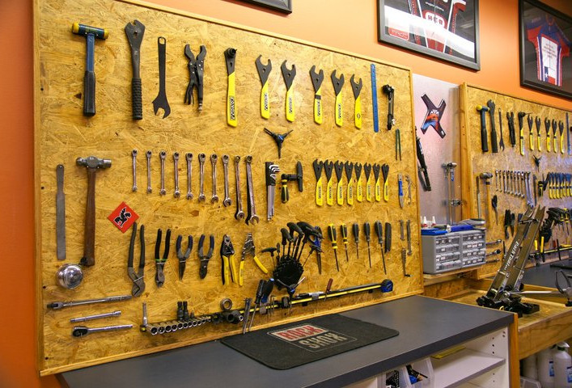
Dictionary For Shop Tools

Slide 2
Tool Box
Notes:
صندوق العدة
उपकरण बक्स

Slide 3
Hammer

Slide 4
Claw Hammer

Slide 5
Sledge Hammer

Slide 6
Rubber Mallet

Slide 7
Flathead Screwdriver

Slide 8
Phillips Head Screwdriver

Slide 9
Pliers

Slide 10
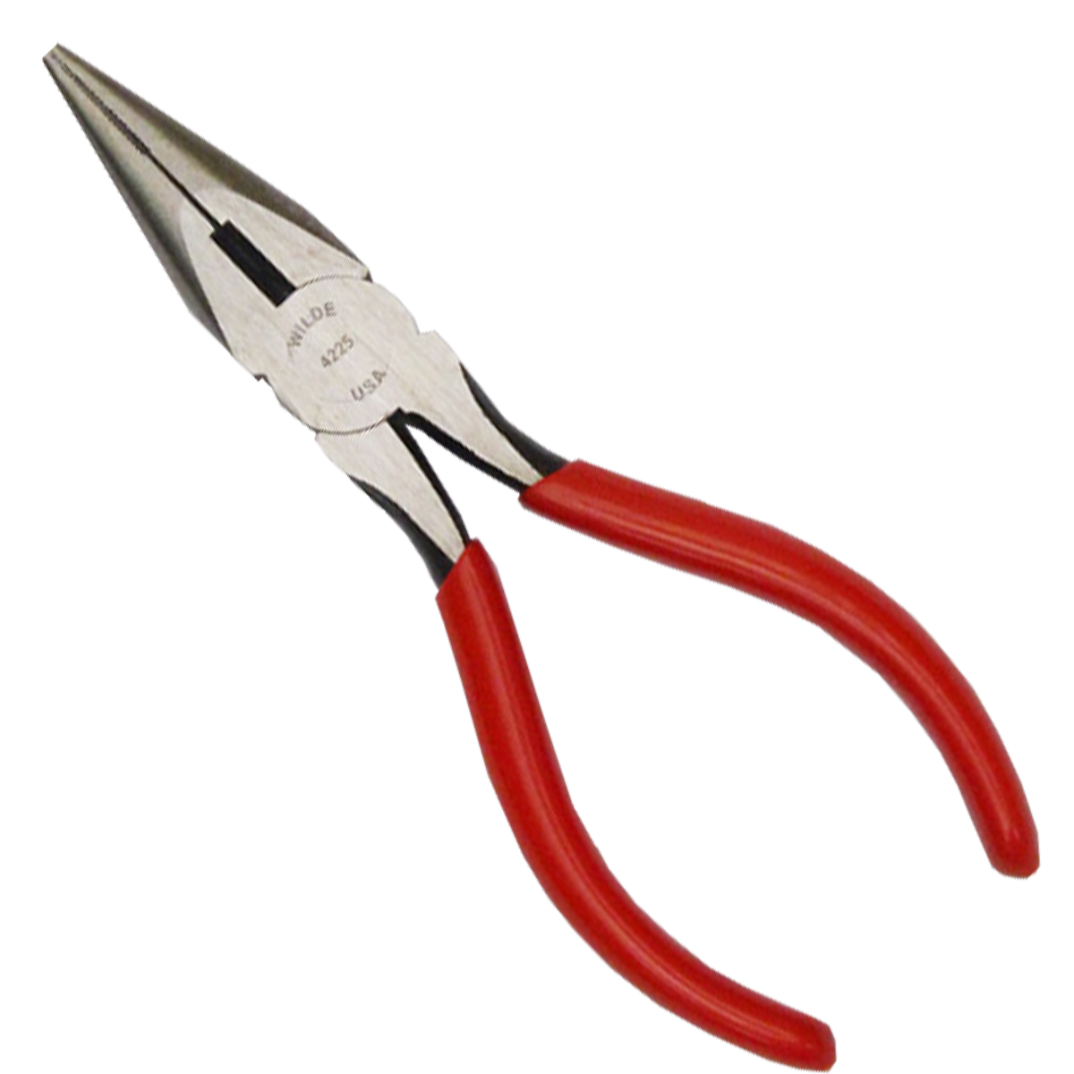
Nose Pliers

Slide 11
Vise Grip Pliers

Slide 12
Cutting Pliers

Slide 13
Wire Stripper

Slide 14
Vise

Slide 15
Squeeze Clamp

Slide 16
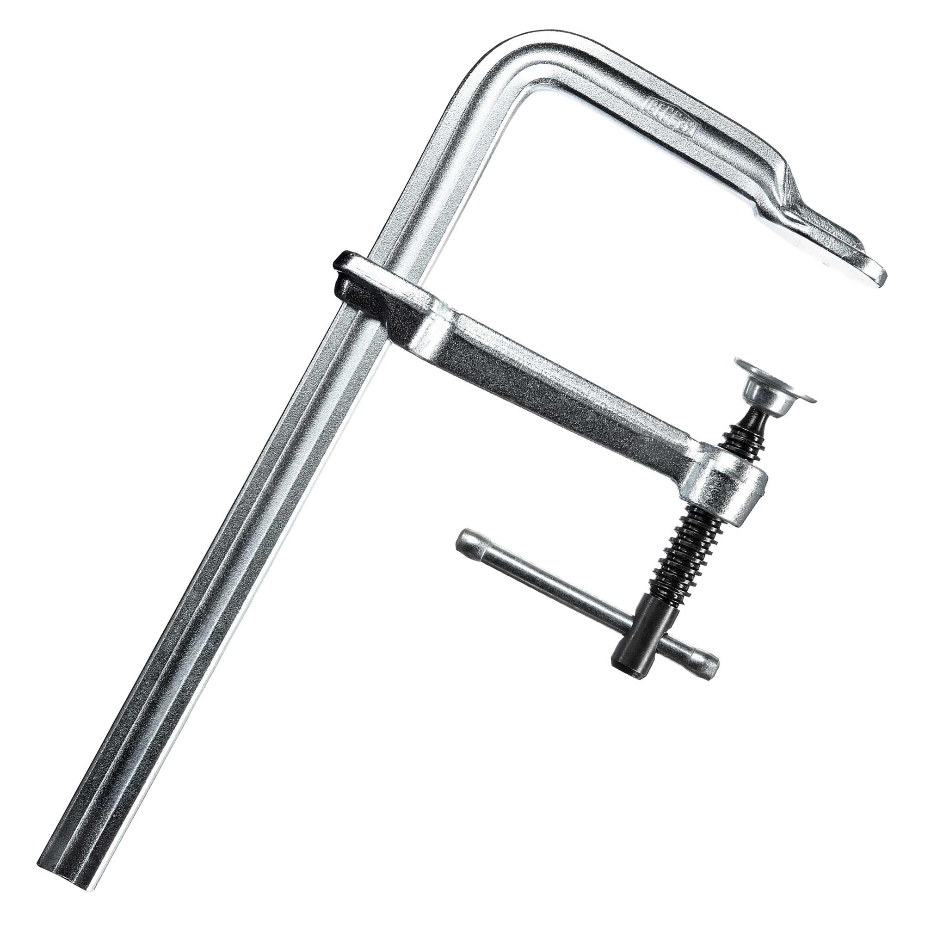
Screw Clamp

Slide 17
Wrench

Slide 18
Crescent Wrench

Slide 19
Allen Wrench

Slide 20
Socket Wrench

Slide 21
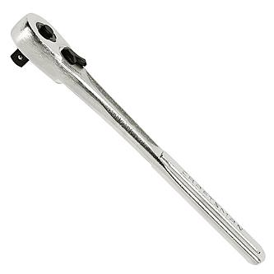
Ratchet

Slide 22
Socket

Slide 23
Socket Extension

Slide 24
Screws

Slide 25
Washers

Slide 26
Nuts

Slide 27
Nails

Slide 28
Pop Rivets

Slide 29
Pop Rivet Gun

Slide 30
File

Slide 31
Rasp

Slide 32
Pipe Wrench

Slide 33
Hacksaw

Slide 34
Handsaw

Slide 35
Blade Knife

Slide 36
Scissors

Slide 37
Snips Cutter

Slide 38
Bolt Cutter

Slide 39
Chisel

Slide 40
Tape Measure

Slide 41
Ruler

Slide 42
Spirit Level

Slide 43
Smart Level

Slide 44
Square

Slide 45
Protractor

Slide 46
Digital Protractor

Slide 47
Micrometer

Slide 48
Digital Micrometer

Slide 49
Scale

Slide 50
Stapler

Slide 51
Duct Tape

Slide 52
Ladder

Slide 53
Step Ladder

Slide 54
Pallet

Slide 55
Safety Glasses

Slide 56
Earplugs

Slide 57
Respirator Mask

Slide 58
Work Gloves

Slide 59
Weld Gloves

Slide 60
Weld Helmet

Slide 61
Hard Hat

Slide 62
Band Aid

Slide 63
Gauge

Slide 64
Wedge

Slide 65
Brush

Slide 66
Wire Brush

Slide 67
Broom

Slide 68
Extension Cord

Slide 69
Drill

Slide 70
Drill Bit

Slide 71
Cordless Drill

Slide 72
Chuck Key

Slide 73
Disk Grinder

Slide 74
DA Sander

Slide 75
Sand Disc

Slide 76
Sand Paper

Slide 77
Scotch Brite Pad

Slide 78
Dynafile

Slide 79
Wire Wheel

Slide 80
Portaband Saw

Slide 81
Air Hose

Slide 82
Air Chuck

Slide 83
Bucket

Slide 84
Crate

Slide 85
Shrink Wrap

Slide 86
Packing Tape

Slide 87
Wrap Foam

Slide 88
Sharpie/Magic Marker

Slide 89
Label Tag

Slide 90
Forklift

Slide 91
Pallet Jack

Slide 92
Dolly

Slide 93
Wheelbarrow

Slide 94
Strap

Slide 95
Bungee Strap

Slide 96
Saw Blade

Slide 97
Paper Towel

Slide 98
Spray Paint

Slide 99
Horse Stand

Slide 100
Roller Stand

